Slide 1
transfer functionS
Aug 31, 2017 Dinesh Babu J

Slide 2
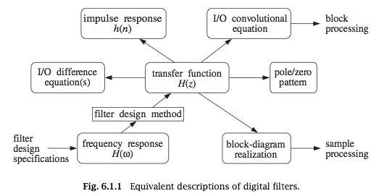

Transfer functions
1
2
3
5
4
6,7
1
2

Slide 3

I/O Difference equation
3

Slide 4
Transfer functions
4

Slide 5



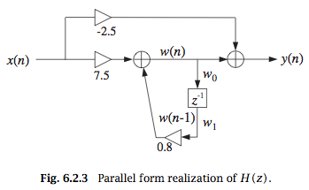
Block Realization (Parallel Form)
4

Slide 6


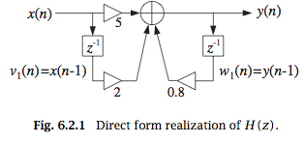

Block Realization (Direct Form)
4

Slide 7

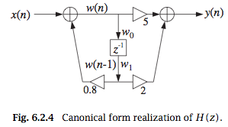
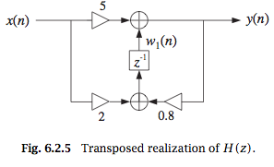
Block Realizations
4

Slide 8
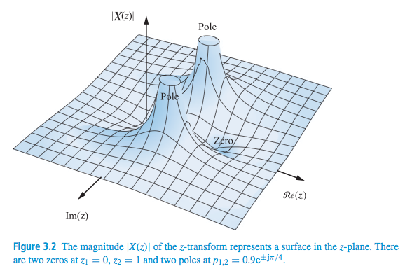

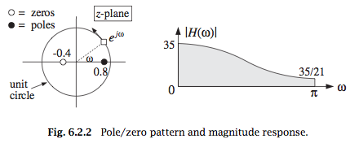
Z- transform -> Poles and Zeros
5

Slide 9

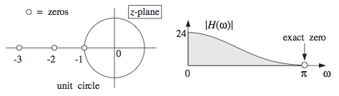
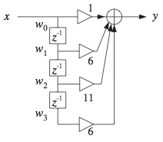
Zeros => Spectrum
6

Slide 10
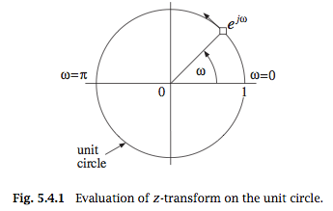

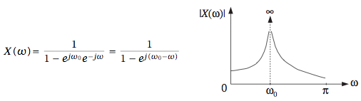
Pole => Spectrum
6

Slide 11


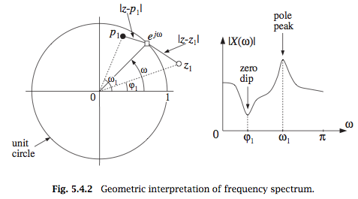
Poles and Zeros => Spectrum
6

Slide 12





Poles and Zeros => Spectrum
6

Slide 13
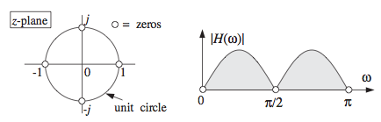
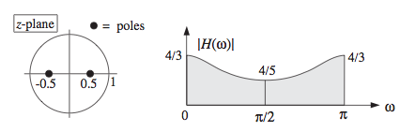
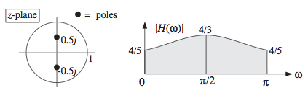
Poles and Zeros => Spectrum
6

Slide 14
Conclusion
Different forms and uses of transfer function
Different implementations
Poles and Zeros affect frequency response

